Slide 1
Data Mining
Prof. Saed Sayad

Slide 2
Statistics and Visualization
N
C
NN
CC
NC
Math
Stat
AI
Univariate
Bivariate
ML
Numerical
Measurement
DM
Explain the past
Exploration
Text
Image
Data Science
Sound
Categorical
Counting
Predict the future
Modeling
Supervised
Unsupervised
N
C
Clustering
Regression
Classification
Association Rules

Slide 3
Data Exploration – Explain the Past
Data Exploration
Univariate Analysis
Average, StDev, Min, Max, ...
Bar, Line, Pie, ...
Charts
Bivariate Analysis
Correlation
Z test, ...
Combination Charts

Slide 4
Modeling – Predict the Future
Classification
K-Means
Association Rules
Recommendation Systems
Regression
Clustering
Decision Tree
KNN
Decision Tree
MLR
KNN
Bayesian
Deep Learning
Random Forest
Deep Learning
Random Forest
Hierarchical

Slide 5
Modeling - Classification
Job
f
Age
Credit Default
Income

Slide 6
Modeling - Regression
Job
f
Age
Credit Score
Income

Slide 7
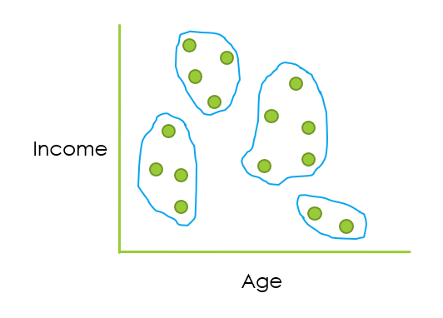
Modeling – Clustering (Segmentation)

Slide 8
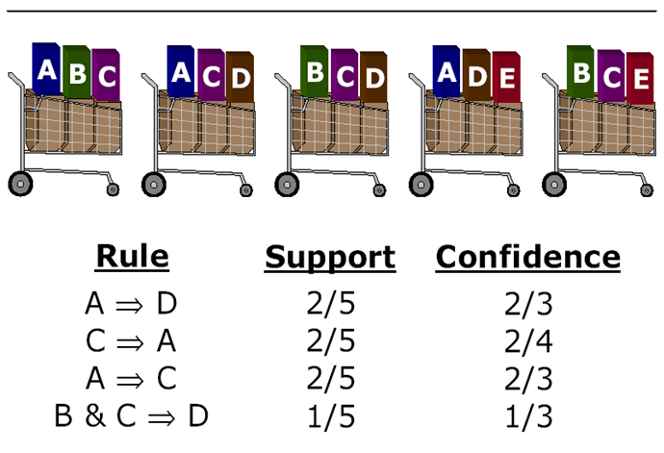
Association Rules
Market Basket Analysis / Recommendation Systems

Slide 9
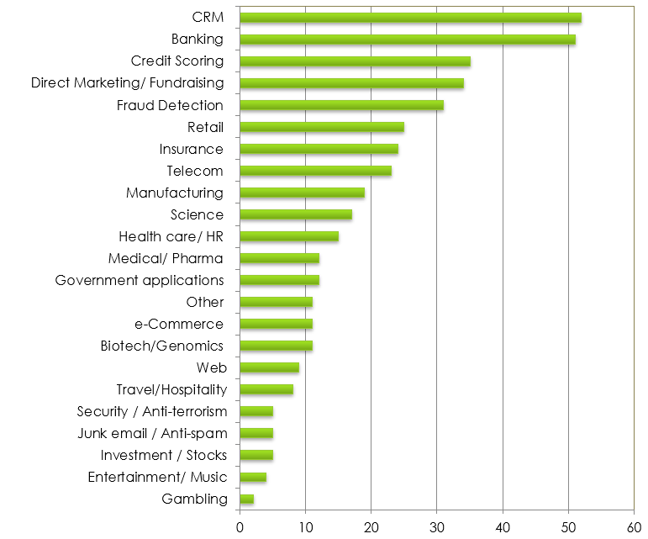
Data mining (science) applications
Source: KDnuggets.com

Slide 10
Data Exploration

Slide 11
Data Exploration
Data
Exploration
Univariate Analysis
Frequency, Mean, Min, Max, ...
Bar, Line, Pie, ...
Charts
Bivariate Analysis
Correlation
Z test, ...
Combination Charts

Slide 12
Data Exploration - Univariate Analysis
Univariate
Analysis
Categorical
Count,
Count%
Bar and Pie Charts
Numerical
Mean, StDev, Kurtosis, …
Histogram,
Box Plot

Slide 13
Univariate Analysis - Categorical
Housing | Count | Count%
for free | 96 | 10.67%
own | 641 | 71.22%
rent | 163 | 18.11%

Slide 14
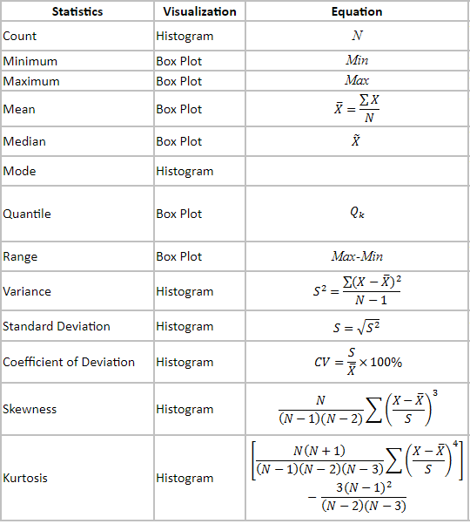
Univariate Analysis - Numeric

Slide 15
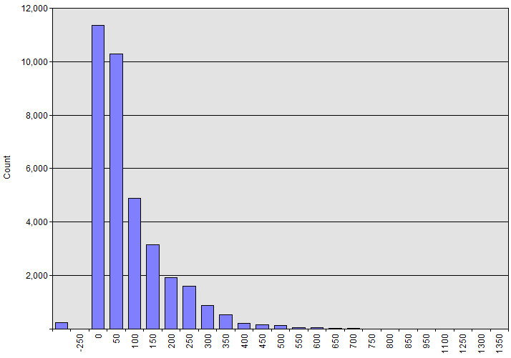
Histogram
Months in Business
Missing values
Invalid values
Outliers?

Slide 16
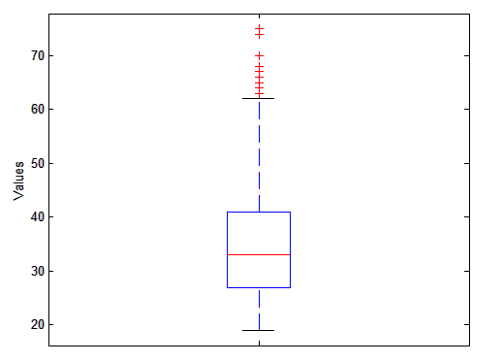
Box Plot
Outliers
*

Slide 17
Binning
Data: 0, 4, 12, 16, 16, 18, 24, 26, 28
Equal-Width:
Bin 1: 0, 4 [-,10) bin
Bin 2: 12, 16, 16, 18 [10,20) bin
Bin 3: 24, 26, 28 [20,+) bin
Equal-Frequency:
Bin 1: 0, 4, 12 [-, 14) bin
Bin 2: 16, 16, 18 [14, 21) bin
Bin 3: 24, 26, 28 [21,+) bin

Slide 18
Encoding
Encoding is the process of transforming categorical variables into numerical counterparts.
Housing {for free, own, rent}
Binary method:
for free: 1, 0, 0
own: 0, 1, 0
rent: 0, 0, 1
Ordinal method:
own: 1
for free: 2
rent: 3

Slide 19
Data Exploration – Bivariate Analysis
Bivariate
Numeric
Numeric
Categorical
Correlation
Scatter Plot
Numeric
Categorical
z-test, t-test, ANOVA
Combination Chart
Chi2 test
Combination Chart

Slide 20
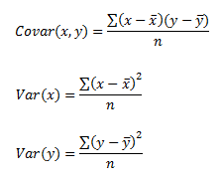
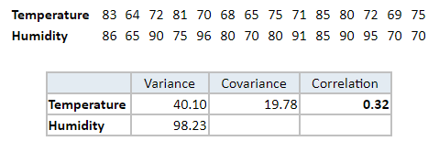
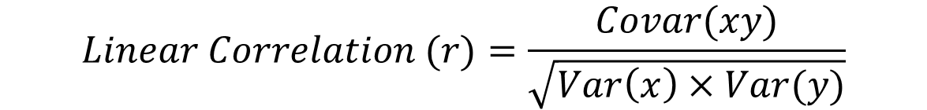
Numeric & Numeric
$$Linear Correlation (r)=\frac{Covar(xy)}{\sqrt{Var\left(x\right)×Var(y)}}$$

Slide 21

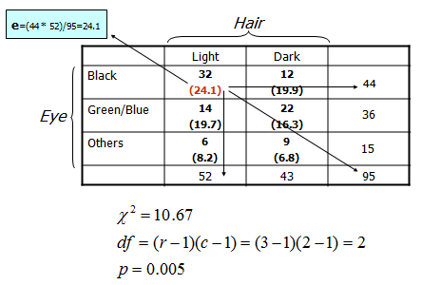

Categorical & Categorical – Chi² Test

Slide 22
Categorical & Numeric – Z Test
Averages
Variances
Counts

Slide 23


Slide 24
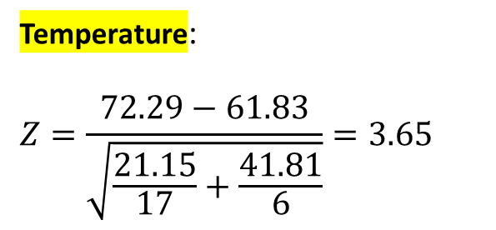
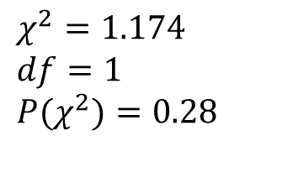

Challenger O-Ring Dataset
Target
Predictors
O-Ring Failure | Launch temperature | Leak-check pressure
N | 66 | Low
N | 69 | Low
N | 68 | Low
N | 67 | Low
N | 72 | Low
N | 73 | Low
N | 70 | Low
N | 78 | High
N | 67 | High
N | 67 | High
N | 75 | High
N | 70 | High
N | 81 | High
N | 76 | High
N | 79 | High
N | 75 | High
N | 76 | High
Y | 70 | Low
Y | 57 | High
Y | 63 | High
Y | 70 | High
Y | 53 | High
Y | 58 | High
Temperature:
$$Z=\frac{72.29−61.83}{\sqrt{\frac{21.15}{17}+\frac{41.81}{6}}}=3.65$$
$$P(Z)=0.0001$$
Pressure | Low | High
N | 7 | 10
Y | 1 | 5
$$χ^{2}=1.174$$
$$df=1$$
$${P(χ}^{2})=0.28$$

Slide 25
Supervised Learning Classification & Regression

Slide 26
K Nearest Neighbors (KNN)
KNN is a simple algorithm that stores all available cases and classifies new cases based on a similarity measure

Slide 27
KNN Classification
Loan$
Age

Slide 28
Similarity - Distance Measure
Euclidean
Manhattan
Minkowski

Slide 29
Similarity – Hamming Distance
Gene 1 | A | A | T | C | C | A | G | T
Gene 2 | T | C | T | C | A | A | G | C
Hamming Distance | 1 | 1 | 0 | 0 | 1 | 0 | 0 | 1

Slide 30
KNN Classification – Distance
Age | Loan | Default | Distance
25 | $40,000 | N | 102000
35 | $60,000 | N | 82000
45 | $80,000 | N | 62000
20 | $20,000 | N | 122000
35 | $120,000 | N | 22000
52 | $18,000 | N | 124000
23 | $95,000 | Y | 47000
40 | $62,000 | Y | 80000
60 | $100,000 | Y | 42000
48 | $220,000 | Y | 78000
33 | $150,000 | Y | 8000
48 | $142,000 | ?
Euclidean Distance

Slide 31
KNN Classification – Standardized Distance
Age | Loan | Default | Distance
0.125 | 0.11 | N | 0.7652
0.375 | 0.21 | N | 0.5200
0.625 | 0.31 | N | 0.3160
0 | 0.01 | N | 0.9245
0.375 | 0.50 | N | 0.3428
0.8 | 0.00 | N | 0.6220
0.075 | 0.38 | Y | 0.6669
0.5 | 0.22 | Y | 0.4437
1 | 0.41 | Y | 0.3650
0.7 | 1.00 | Y | 0.3861
0.325 | 0.65 | Y | 0.3771
0.7 | 0.61 | ?
Standardized Variable

Slide 32
KNN Regression - Distance
Age | Loan | House Price Index | Distance
25 | $40,000 | 135 | 102000
35 | $60,000 | 256 | 82000
45 | $80,000 | 231 | 62000
20 | $20,000 | 267 | 122000
35 | $120,000 | 139 | 22000
52 | $18,000 | 150 | 124000
23 | $95,000 | 127 | 47000
40 | $62,000 | 216 | 80000
60 | $100,000 | 139 | 42000
48 | $220,000 | 250 | 78000
33 | $150,000 | 264 | 8000
48 | $142,000 | ?

Slide 33
KNN Regression – Standardized Distance
Age | Loan | House Price Index | Distance
0.125 | 0.11 | 135 | 0.7652
0.375 | 0.21 | 256 | 0.5200
0.625 | 0.31 | 231 | 0.3160
0 | 0.01 | 267 | 0.9245
0.375 | 0.50 | 139 | 0.3428
0.8 | 0.00 | 150 | 0.6220
0.075 | 0.38 | 127 | 0.6669
0.5 | 0.22 | 216 | 0.4437
1 | 0.41 | 139 | 0.3650
0.7 | 1.00 | 250 | 0.3861
0.325 | 0.65 | 264 | 0.3771
0.7 | 0.61 | ?

Slide 34
Challenger O-Ring Dataset
Target
Predictors
O-Ring Failure | Launch temperature | Leak-check pressure
N | 66 | Low
N | 69 | Low
N | 68 | Low
N | 67 | Low
N | 72 | Low
N | 73 | Low
N | 70 | Low
N | 78 | High
N | 67 | High
N | 67 | High
N | 75 | High
N | 70 | High
N | 81 | High
N | 76 | High
N | 79 | High
N | 75 | High
N | 76 | High
Y | 70 | Low
Y | 57 | High
Y | 63 | High
Y | 70 | High
Y | 53 | High
Y | 58 | High

Slide 35
Unsupervised Learning Clustering (Segmentation)

Slide 36
What is Clustering?
Given a set of records, organize the records into clusters
Income
A cluster is a subset of records which are similar
Age

Slide 37
Similarity - Distance Measure
Euclidean
Manhattan
Minkowski

Slide 38
Similarity – Hamming Distance
Gene 1 | A | A | T | C | C | A | G | T
Gene 2 | T | C | T | C | A | A | G | C
Hamming Distance | 1 | 1 | 0 | 0 | 1 | 0 | 0 | 1

Slide 39
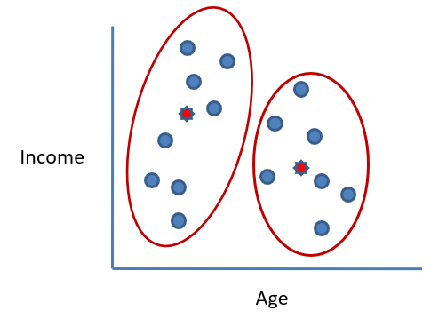
K-Means Clustering
Clusters the data into k groups where k is predefined.
Select k points at random as cluster centers.
Assign observations to their closest cluster center according to the Euclidean distance function.
Calculate the centroid or mean of all instances in each cluster (this is the mean part)
Repeat steps 2, 3 and 4 until the same points are assigned to each cluster in consecutive rounds.

Slide 40
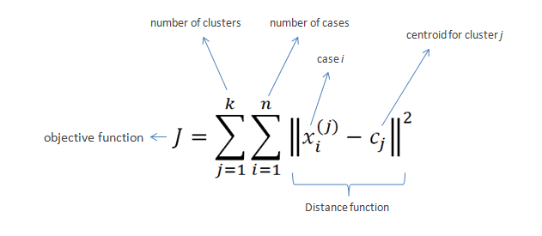
K-Means Clustering

Slide 41
K-Means - Example
15,15,16,19,19,20,20,21,22,28,35,40,41,42,43,44,60,61,65
$$n=19$$
$$k=2$$
D$istance 1=\sqrt{{(x_{i}−c_{1})}^{2}}$
D$istance 2=\sqrt{{(x_{i}−c_{2})}^{2}}$
$$c_{1}=16$$
$$c_{2}=22$$

Slide 42
Iteration 1

Slide 43
Iteration 2

Slide 44
Iteration 3

Slide 45
Iteration 4

Slide 46
Clustering - Applications
Marketing: finding groups of customers with similar behavior
Biology: classification of plants and animals given their features
City-planning: identifying groups of houses according to their house type, value and geographical location
World Wide Web: document classification; clustering weblog data to discover groups with similar access patterns

Slide 47
Challenger O-Ring Dataset
Target
Predictors
O-Ring Failure | Launch temperature | Leak-check pressure
N | 66 | Low
N | 69 | Low
N | 68 | Low
N | 67 | Low
N | 72 | Low
N | 73 | Low
N | 70 | Low
N | 78 | High
N | 67 | High
N | 67 | High
N | 75 | High
N | 70 | High
N | 81 | High
N | 76 | High
N | 79 | High
N | 75 | High
N | 76 | High
Y | 70 | Low
Y | 57 | High
Y | 63 | High
Y | 70 | High
Y | 53 | High
Y | 58 | High

Slide 48
Association Rules

Slide 49
Association Rules (AR)
Association Rules find interesting associations and/or correlations amongst a large set of data items
Two widely-used examples of association rule mining is Market Basket Analysis and Recommendation Systems

Slide 50
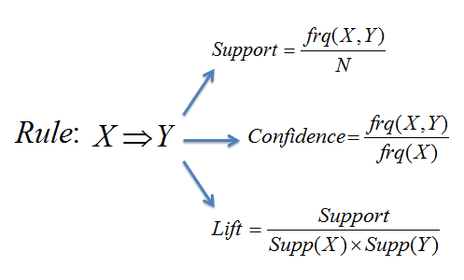
AR – Support and Confidence

Slide 51
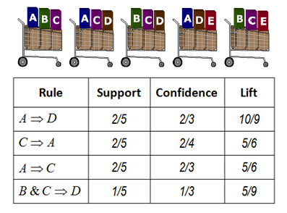
AR – Support and Confidence

Slide 52
Apriori Algorithm
Database
1
2
TID | Items
100 | A C D
200 | B C E
300 | A B C E
400 | B E
Itemset | Support
{D} | 1
{A} | 2
{B} | 3
{C} | 3
{E} | 3
Itemset | Support
{A B} | 1
{A C} | 2
{A E} | 1
{B C} | 2
{B E} | 3
{C E} | 2
Support > 1
Itemset | Support
{B C E} | 2
3

Slide 53
www.saedsayad.com

